Slide 1


ERA: Emergency Response Assist
Weekly Status Report
Jatin Madan; Sharvesh Patki; Isha Ghiria; Vaishnavi Desai
May 29, 2024

Slide 2
Meet the ERA Team
Vaishnavi Sunil Desai
Isha Ghiria
Sharvesh Patki
Jatin Madan

Slide 3
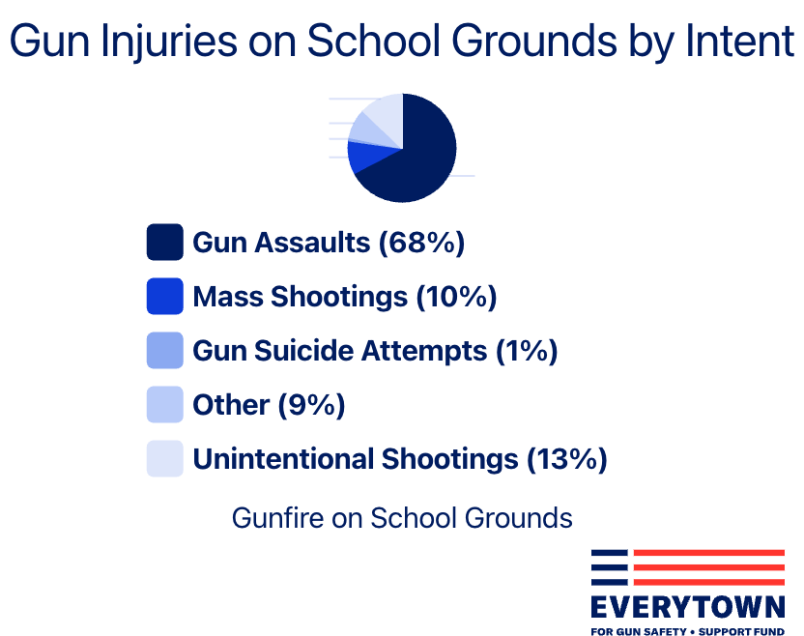
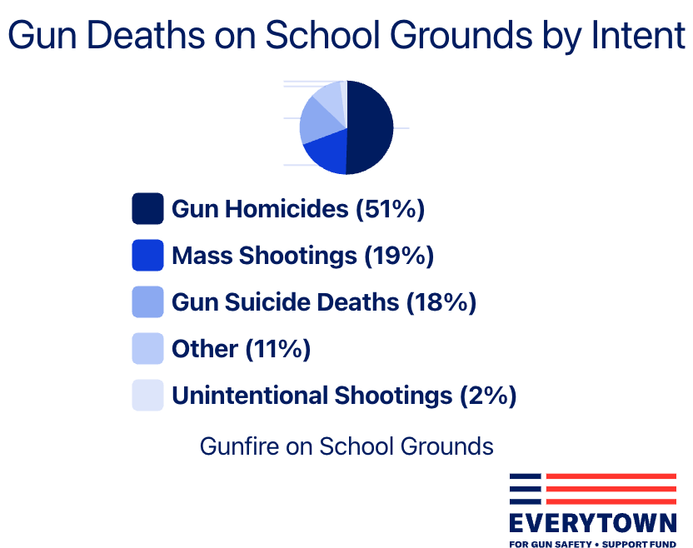
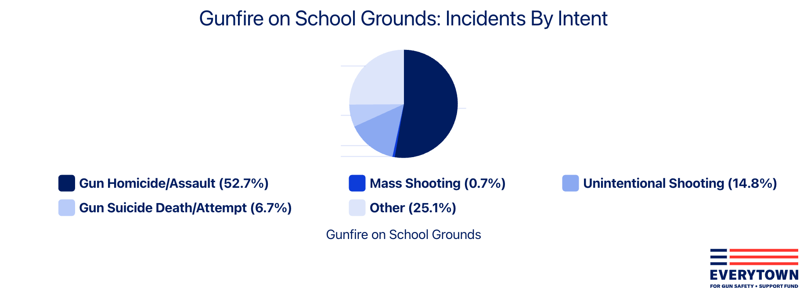
Current Problems in Campus Safety
Inadequate Real-Time Response:
Issue: Existing systems often have significant delays in detecting and responding to emergencies, reducing their effectiveness.
Impact: Delays can result in increased risk to safety and security, potentially leading to harm before help arrives.
Limited Threat Detection Capabilities:
Issue: Many systems only react to threats they are specifically programmed to detect, such as unauthorized entry, without the ability to localize sounds or movements related to other types of emergencies like shootings.
Impact: This limitation restricts the system's ability to effectively manage diverse and dynamic emergency situations, leaving gaps in campus security.
Inefficient Evacuation Support:
Issue: Lack of integration between emergency alerts and actionable evacuation instructions can lead to chaos and confusion during evacuations.
Impact: Without clear and dynamic guidance, individuals may not find the safest exit routes, potentially leading to bottlenecks and increased risk during evacuations.
Scalability and Flexibility Issues:
Issue: Many systems are not designed to scale or adapt with growing campus environments or evolving technology landscapes.
Impact: The inability to scale or adapt can make systems obsolete more quickly and hinder their effectiveness as campus layouts and populations change.
Notes:
Imagine you're walking through your campus on a bustling Monday morning, birds chirping, students chatting, and the sun shining. Everything seems normal, until suddenly, a loud noise echoes through the air. Is it construction? Or something more sinister?
This scenario illustrates one of the key issues with campus safety: inadequate real-time response. Existing systems often suffer from delays in detecting and responding to emergencies. It's like having a security guard who takes a nap when they should be vigilant. These delays can increase the risk to everyone on campus, as help might not arrive in time to prevent harm.
Now, picture this: You're in the middle of a lecture when suddenly, there's a commotion outside the classroom. Is it just a loud group of students or something more serious, like an active shooter? Unfortunately, many current safety systems are like one-trick ponies. They're only programmed to detect specific threats, like unauthorized entry, but they lack the ability to identify other types of emergencies, such as shootings.
Let's say an emergency does occur, and the campus needs to be evacuated. You receive an alert on your phone instructing you to evacuate, but it's vague and doesn't provide clear guidance on the safest exit routes. It's chaos. People are running in all directions, trying to find a way out, but they're confused and disoriented. Without clear and dynamic instructions, evacuations can quickly turn into a dangerous mess, with bottlenecks forming and increasing the risk to everyone involved.
Lastly, think about how your campus is constantly evolving. New buildings are constructed, populations grow, and technology advances. But unfortunately, many safety systems aren't designed to keep up with these changes. They're rigid and inflexible, like trying to fit a square peg into a round hole. As a result, they quickly become outdated and less effective at keeping the campus safe.
In essence, campus safety isn't just about having the right systems in place; it's about ensuring those systems can adapt and respond effectively to any situation that arises.

Slide 4
Objectives of ERA
Key Objectives
1.
Gunshot Detection and Localization: The emergency response system will incorporate gunshot detection and localization capabilities. This feature enhances the system's ability to swiftly identify and respond to active shooter incidents, further bolstering campus security and safety measures.
We have a desire to create a system that can assist people in case of emergencies by locating them and providing the safest exit routes to the affected.
To move toward achieving these goals, we need to build advanced machine learning and triangulation algorithms to assist the people
2.
Real-Time Tracking Algorithms: In conjunction with the existing features, the emergency response system will incorporate
real-time network tracking algorithms linked with network access points across the university campus. This feature enhances the system's ability to monitor and track the movement of individuals during emergencies, facilitating targeted assistance and evacuation procedures.
3.
Planning Escape Routes: In addition to advanced threat detection and real-time tracking capabilities, the emergency response system will integrate a feature for planning escape routes using the provided floor plans of university buildings and facilities. This feature will enhance the system's ability to guide individuals to safety during emergencies such as active shooter incidents, fires, or natural disasters.

Slide 5
ERA – A Modular Approach
ERA Key Components
Simplifies the process of incorporating building layout data into the system, ensuring accurate and efficient planning of emergency response strategies.
User Input Interface
Streamlined Data Input: The interface facilitates easy input of crucial information like floor plans, access points, and audio sensors.
Comprehensive Metadata Repository: A "Metadata" section serves as a repository for network configurations, sensor specifications, and building layout details.
Network Logs Analyzer
Centralized Logging Server Connectivity: Orchestrates retrieval of network logs from a centralized repository, enhancing efficiency.
Identification of Users and Devices: Analyzes network logs to map user activities, strengthening security measures.
Early detection of unauthorized devices allows for prompt action to prevent potential security breaches and safeguard network integrity.
Seamless Sensor Interface: Establishes seamless communication with deployed acoustic sensors, ensuring reliable data transmission.
Swift Gunshot Detection: Evaluates audio signals for gunshot detection using sophisticated algorithms, enabling rapid response.
High precision in gunshot detection minimizes false alarms and ensures timely response to active shooter incidents, enhancing campus security.
Sensor Connectors
Prompt notification of first responders enables swift intervention and mitigation of risks. Alert Nearby Devices via Emergency Push Notification
Notification API
Prompt First Responder Notification: Initiates notifications to first responders promptly upon detecting emergency situations.
Nearby Devices Alert: Swiftly alerts nearby devices via emergency push notifications, fostering collective awareness.
Real-time tracking of affected devices allows for dynamic response to evolving situations, ensuring the safety of individuals in crisis scenarios.
User Localization
Accurate User Positioning: Employs triangulation techniques to pinpoint user positions accurately, enhancing response efforts.
Real-time Device Tracking: Tracks affected devices in real-time, enhancing situational awareness during emergencies.
Escape Route Detection
Timely Identification of Exit Points: Swiftly identifies nearest exit points for timely evacuation during emergencies.
Safe Route Generation: Devises safe routes, circumventing any emergency blockers, ensuring secure evacuation.
Avoidance of emergency blockers reduces risks during evacuation, ensuring the safety of individuals and responders.
Notes:
ERA provides a modular approach to campus security, as it works with 6 modules designed to be developed and scaled independently.
Our primary module is the User Input Interface

Slide 6
The team will initiate several key activities during the next four (4) weeks, including but not limited to researching efficient algorithms to triangulate users and prepare an exit route for emergency situations
Key activities planned for the next four (4) weeks
Team ERA
Integrate the 3 individual Modules into a Cohesive Application using the Main ERA Server as the Hub
Beautify and Materialize the Front-End Applications to give it a modern look and feel.
Build the Notification API to alert the First Responders and the ERA Administration
Implement the Escape Route Sharing Module to display the closest and the safest route.
WEEK 4-6
Test the simulation software for the Network Access Points to test User Triangulation
Setup CI/CD and DevSecOps Platform for ERA Software Management and Deployments
Materialize and Beautify the Frontend Applications to serve as the dashboard.
Try and Validate Existing Route Detection ML Algorithms
Test out the Notification Module
WEEK 6-8

Slide 7
Weekly status report – As of 05/29/2024
Current Project Status
Current Period | Previous Period | Trend | % Complete | Finish Date
 |  |  | 90% | 05/31/24
User Stories/Risks/Issues/Decisions/Milestones
R/I | Brief Description | Due Date
I | Build and Deploy API for Gunshot Detection | 05/04/2024
2 | Build and Deploy API for Network Logs Simulation | 05/04/2024
3 | Build the Front-end UI for ERA Dashboard | 05/04/2024
4 | Build the Front-end UI for ERA Floor Plan Input | 05/04/2024
5 | Establish the Main ERA Server to serve as the Integration Hub | 05/04/2024
G
G
Key Accomplishments: Integrated all 3 Modules into a Cohesive Application using the Main ERA Server as the Hub: Successfully combined the three modules, ensuring seamless communication and data flow through the central ERA server, establishing a unified and efficient system. Beautified and Materialized the Front-End Applications to give it a modern look and feel: Enhanced the front-end applications with modern design principles, resulting in a visually appealing and user-friendly interface that meets contemporary aesthetic standards. Built the Notification API to alert the First Responders and the ERA Administration: Developed and deployed a robust Notification API, effectively enabling real-time alerts and updates for first responders and ERA administrators, ensuring timely and efficient response actions. Implemented the Escape Route Sharing Module to display the closest and safest route: Successfully created and integrated the Escape Route Sharing Module, providing users with real-time information on the nearest and safest escape routes, enhancing overall safety and navigation efficiency.
Deliverables | Finish Date | % Complete | Status
 | (Planned)
Project plan | 05/05/24 | 100% | C
User stories for ERA Development operations | 05/05/24 | 100% | C
ERA System Architectural Diagram | 04/16/24 | 100% | C
Agile Release Roadmap | 04/20./24 | 100% | C
Completed 01 sprints and below is the snapshot of the current sprint [01]
Github project archive | 05/05/24 | 100% | C
Perform Active User Simulation for ERA | 06/14/24 | 100% | C
ERA View/Update dashboard | 06/14/24 | 100% | C
Knowledge base articles for ERA System | 06/14/24 | 0% | G
Process workflow documentation | 06/14/24 | 0% | G
Activities planned for next period: User Testing and Feedback Collection: Conduct thorough user testing with various stakeholders, including first responders and ERA administrators. Collect feedback to identify any usability issues, bugs, or areas for improvement. Security Enhancements: Implement advanced security measures to protect sensitive data and ensure the system is resilient against potential cyber threats. Documentation and Training Materials: Develop comprehensive documentation and training materials for users and administrators to facilitate smooth adoption and effective use of the system. Integration with External Systems: Explore opportunities to integrate the ERA system with other emergency response systems or databases to enhance its functionality and data accuracy. Scalability Testing: Conduct scalability tests to ensure the system can handle increased load as the user base grows, particularly during emergencies. Marketing and Outreach: Develop a marketing and outreach strategy to promote the ERA system to potential users and stakeholders, including universities and emergency response teams.
G
On Track
A
Monitor Closely
C
Complete
Trending:
Improving trend for future
No change
Worsening trend for future

Slide 8
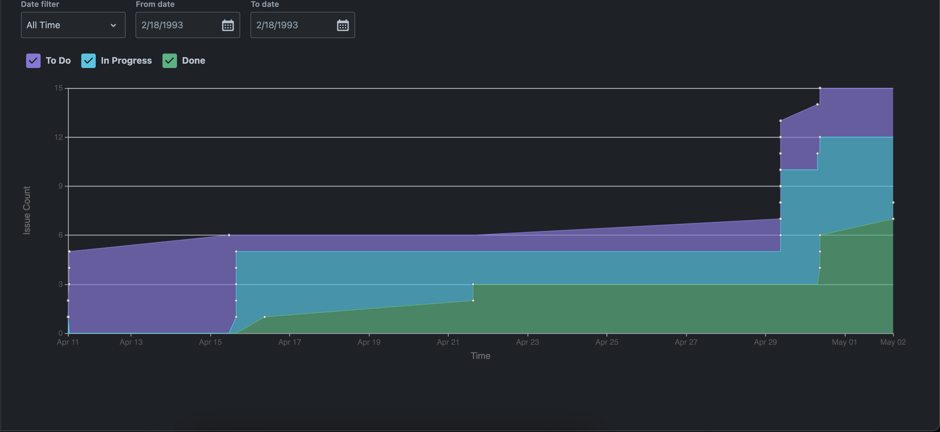
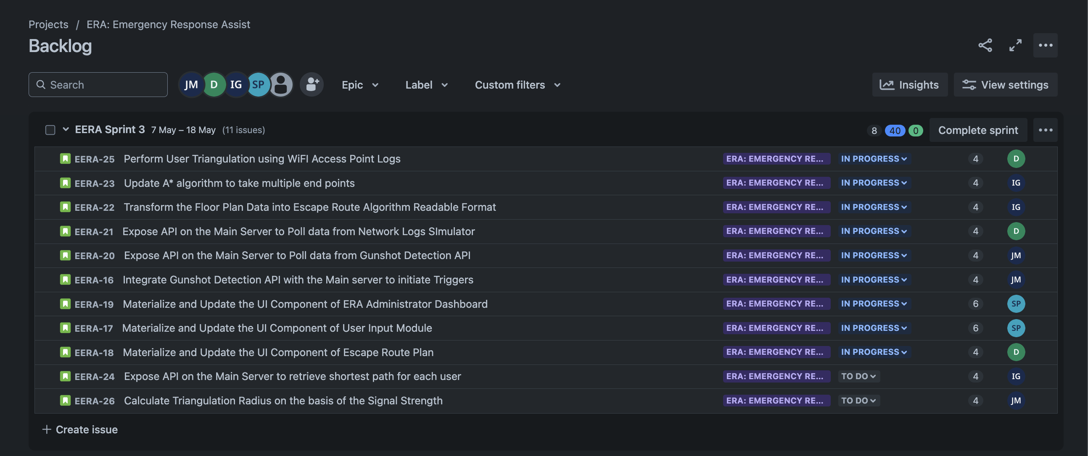
Sprint Cumulative Flow Diagram

Slide 9
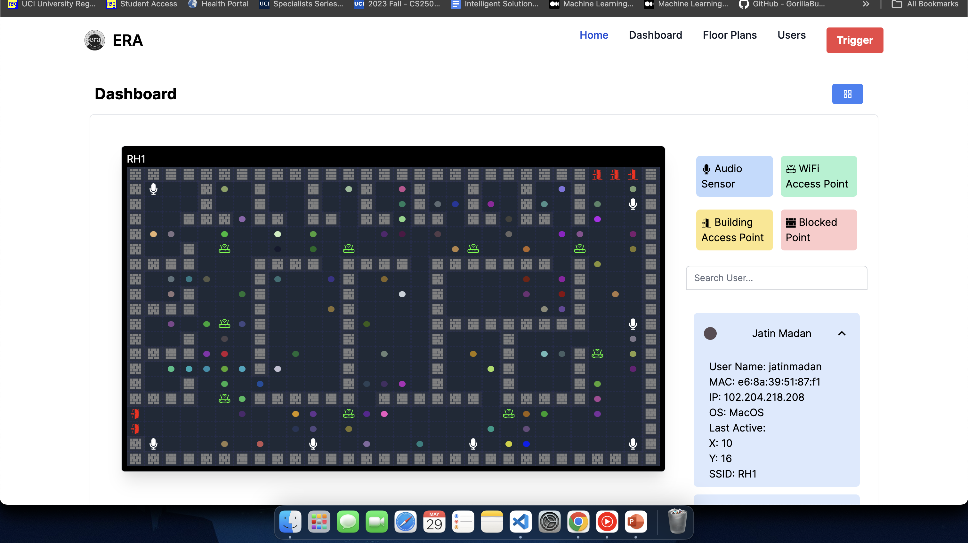
ERA Administrator Dashboard

Slide 10


Slide 11
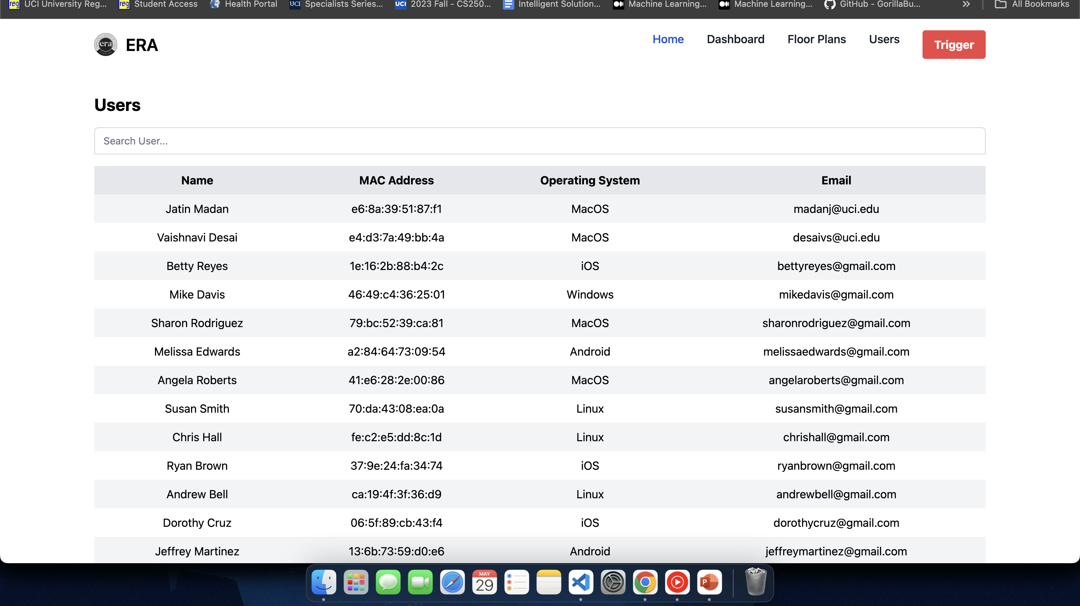

Slide 12
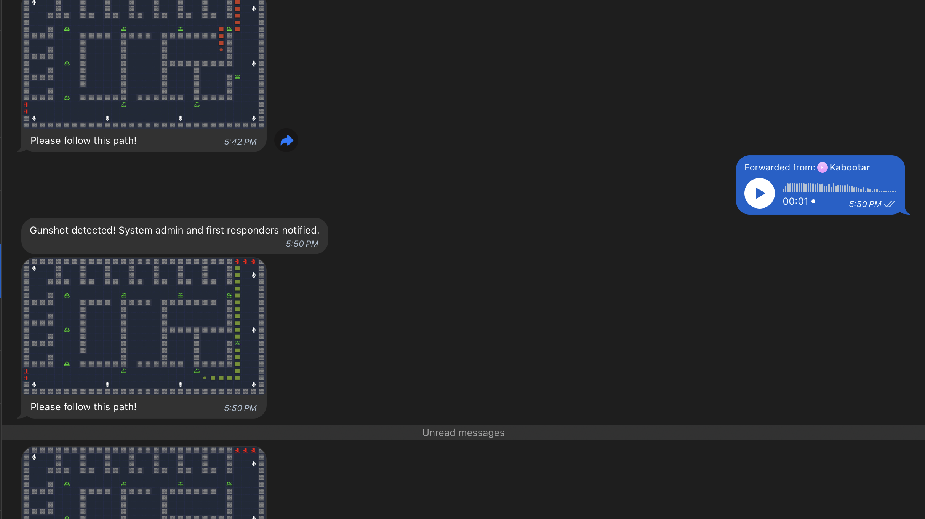
Telegram Messaging Integration

Slide 14
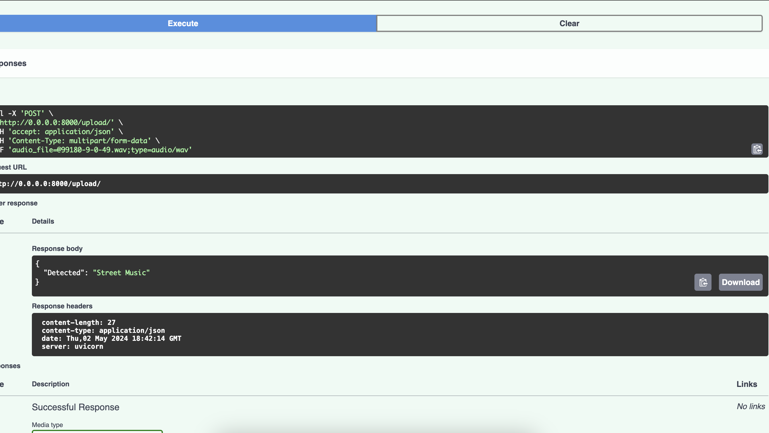
ERA: Gunshot Detection model Accuracy

Slide 15
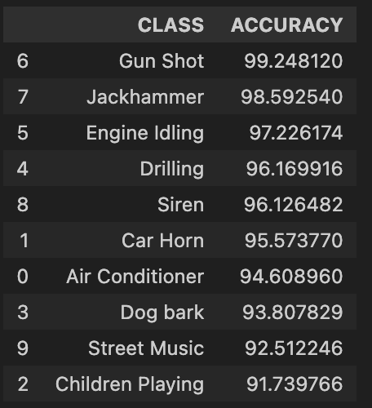
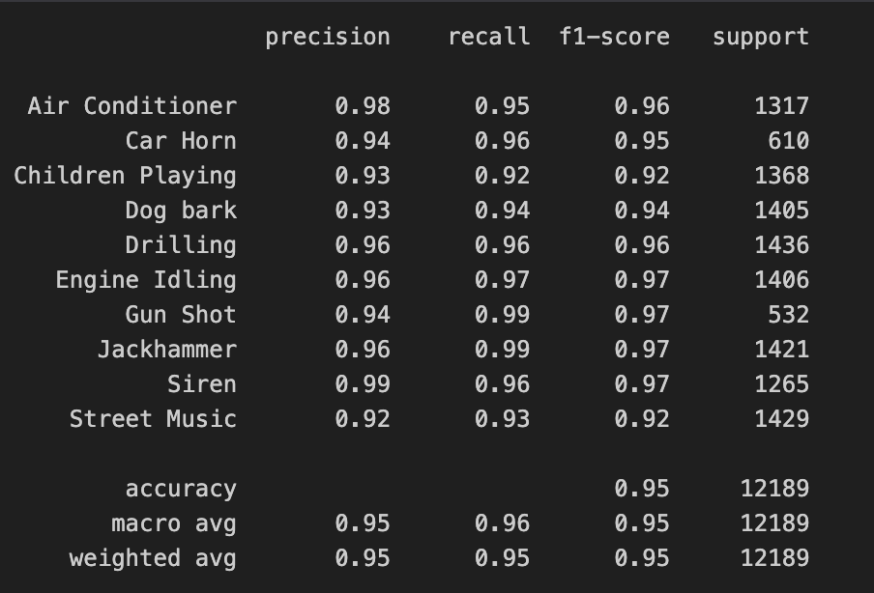
ERA: Gunshot Detection model Accuracy and Demo

Slide 16

Questions?

Slide 17
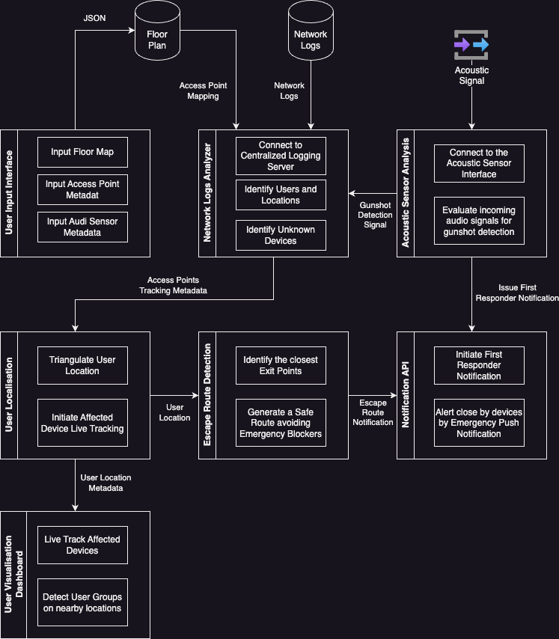
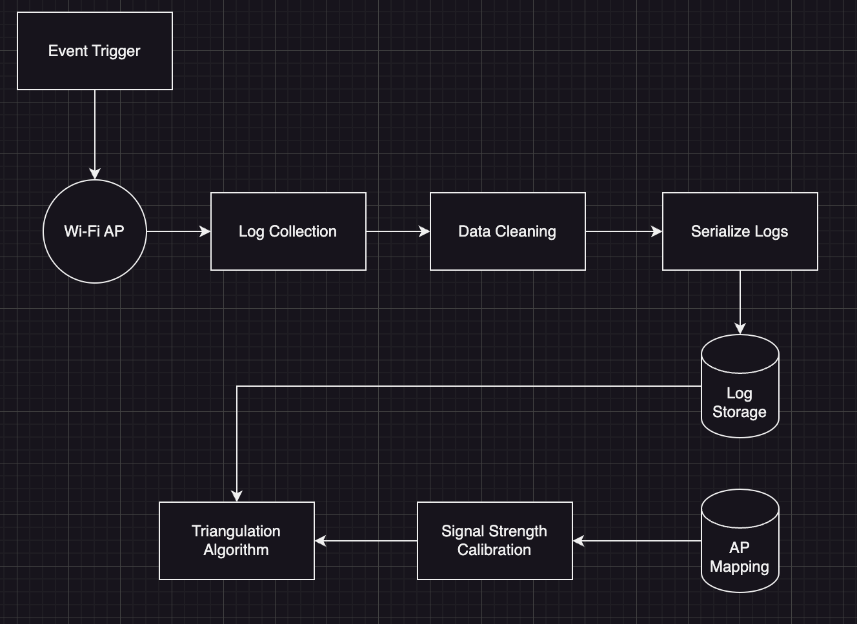
Architecture Diagram
Network Logs Analysis

